Slide 1
Corpus linguistics:
Pitfalls and problems
John Blake
Japan Advanced Institute of Science and Technology

Slide 2
Research context
Postgraduate research institute in Japan
Scientific and Technology
Abstracts - Japanese & English
Theory to underpin a tool to help researchers draft abstracts in English
02

Slide 3
Four-step (linear/recursive) Process
Research is presented in a linear manner (Latour & Woolgar, 1986)
But, research is often a messy, recursive non-linear process…
Design
Construction
Annotation
Analysis
04

Slide 4
Critique the method. 19 questions arose from critically evaluating a 5-sentence description.
03

Slide 5
i. A corpus-based study of scientific research abstracts (SRAs) written in English in the field of Information Science
05

Slide 6
1. Why choose a corpus study?
Fastest growing methodology in linguistics (Gries, forthcoming) – Ad populum?
Insufficiency of relying on intuition (Hunston, 2002; Reppen, 2010) – Hasty generalization?
Importance of frequency and recurrence (Stubbs, 2007)
06

Slide 7
2. Why choose corpus-based approach?
Choices
Corpus-driven (Tognini-Bonelli, 2001)
Corpus-based
Corpus-informed
Problems
Confirmation bias
Cherry picking
07

Slide 8
3. Why focus on SRAs?
Problems - drafting SRAs for novice researchers & NNESs
Gap in research - Few large-scale studies of RAs, No holistic studies of SRAs. No corpus studies in information science
Importance
Address the problems and fills the gap
Meets needs of doctoral students & faculty
08

Slide 9
4. Why study this topic?
Importance
SRAs (already discussed)
“publish in English or perish”
(Ventola, 1992, p.191).
Growth in Information science
09

Slide 10
ii. A tailor-made corpus of all abstracts (n=1581) published in 2012 in 5 IEEE journals was created.
10

Slide 11
5. Why create a corpus rather than use an existing one?
Purpose is paramount (Nelson, 2010)
Corpus needs to be representative of language under investigation (Reppen, 2012)
No existing corpus of SRAs in Info. Science
11

Slide 12
6. Why choose that sample size?
Size is a vexed issue (Carter & McCarthy, 2001)
Bigger is better (Sinclair, 1991) Hapax legomena
Balanced and representative is better e.g. Domain-specific research …smaller corpora (Hunston, 2002)
Ballpark figures
80% of all corpus studies on RAs (n<100 texts)
5% of all corpus studies on RAs (n>100 texts)
12

Slide 13
7. Why 1581 texts? Is it balanced?
Size related to practicality (McEnery & Hardie, 2012.
Isotextual vs. Isolexical (Oakey, 2009)
“the solution may be to include all issues of the selection of publications from a given week, month or year. This will allow the proportions to determine themselves.” (Hunston, 2002)
13

Slide 14
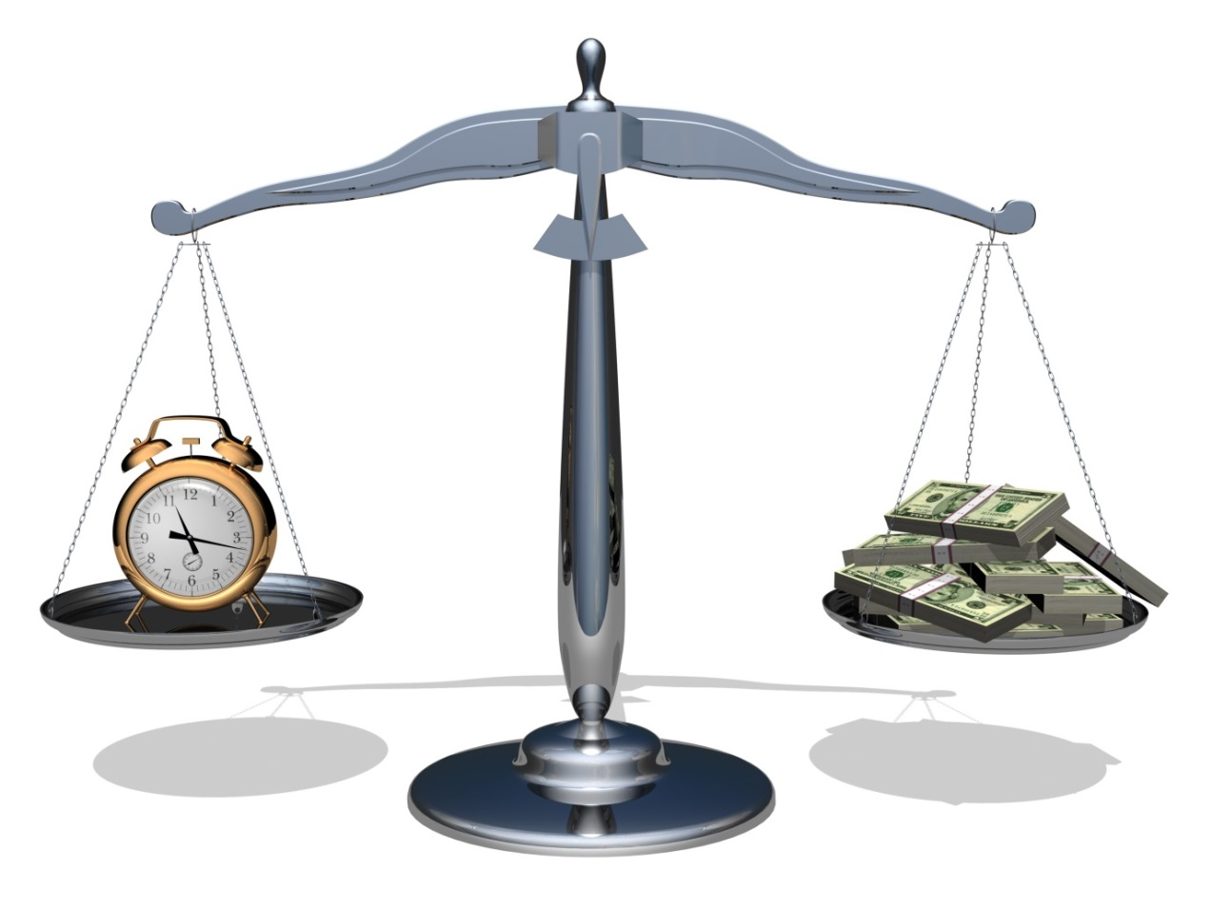
8. How much time or money is needed?
Collect 50, then estimate for whole sample
Estimate efficiency gains
Automate?
Outsource?
14

Slide 15
9. Why 5 IEEE journals?
Selection of publication
Representativity
Balance
Size
Why 5?
Why journals not conference proceedings?
Why IEEE?
15

Slide 16
10. Permission necessary?
Permission from editors, authors?
Terms of use of IEEE Xplore
permission to download texts,
prohibit any form of sharing texts.
Problem
cannot share so need to ensure replicability through detailed method
16

Slide 17
iii. The corpus was collected manually according to a fixed protocol, checked, and then clean versions stored securely in triplicate.
17

Slide 18
11. How to collect the corpus?
Automatic or manual
Copy, paste and save one text in one text file (txt)
Concatenate files later if necessary
Create a hotkey for repetitive key strokes
18

Slide 19
12. How to create an error-free corpus?
Standard operating procedure (protocol)
Systematic
Written & verifiable (need for method anyway)
Built-in checks
Reduce accuracy errors
Similarity analysis to identify duplicates
Tools, such as Ferret (Lyon, Malcolm and Dickerson, 2001)
Found duplicate SRA….but the journal had published one article, twice!
19

Slide 20
13. How and where to store?
Securely, e.g. encrypted (protect data)
Three locations (offline, online & working)
Fire in office destroys offline & working
Virus destroys online & working
In both cases, one corpus survives
20

Slide 21
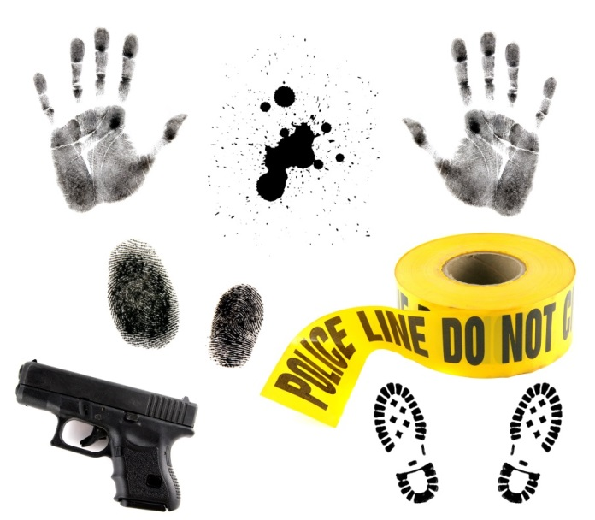
14. Should nonsensical characters and typos be deleted for the text files?
Clean corpus policy
Version 1: clean for record
Version 2: deleted
nonsensical characters
corrected erroneous typos
deleted within breaks
21

Slide 22
iv. The corpus was annotated using UAM Corpus Tool, in layers using specially-created code sets and part-of-speech coding.
22

Slide 23
15. Why the UAM Corpus Tool?
Designed for functional analysis Code in multiple layers.
Easy to use but ver.2.8
multiple crashes
Spanish explanatory videos and help forum
Ver 3.0 (O'Donnell, 2014) much more stable
23

Slide 24
16. Selection of annotation code sets?
Standard tag sets
Part-of-speech
(tag set & tagger or built-in concordance tool)
FOG tag set, e.g. some UAM corpus tool
Tailor-made tag sets
Categories necessary for research purpose …
24

Slide 25
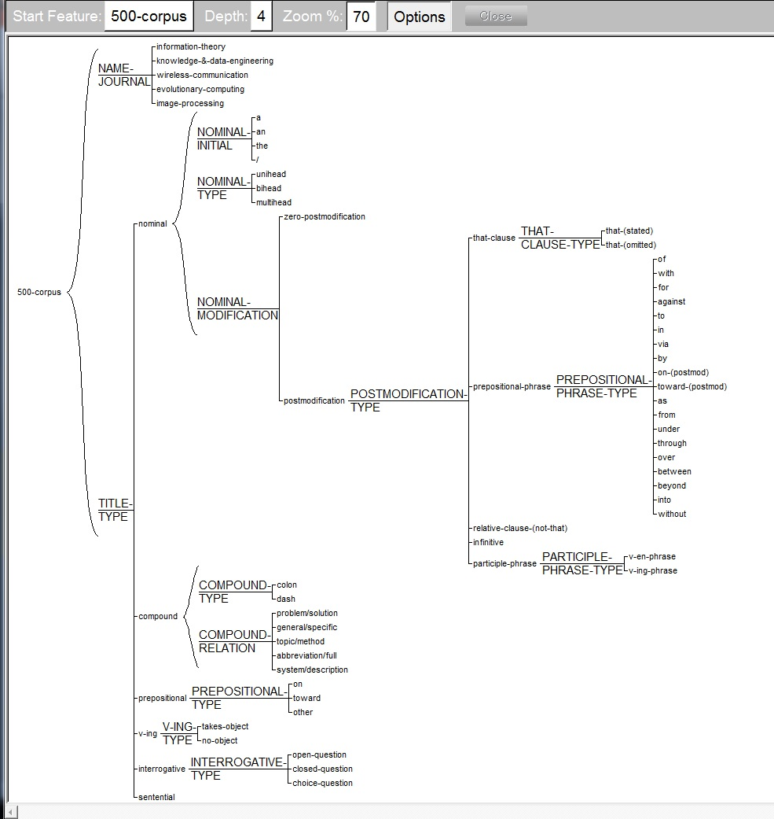
Coding for titles
Title type
2
Features & sub-features
1
UAM Corpus Tool v. 2.8.14
7
25

Slide 26
v. Specialist Informants coded a selection of SRAs and reliability was compared.
22

Slide 27
17. Inter- and intra-coder reliability?
Coders and coding
Specialist vs. Linguist
Intra and inter
Statistical comparison
Kappa statistic (Carletta, 1996)
Sufficient degree of accuracy (gold standard?)
Ontological units give very different results
(word, sentence, text)
26

Slide 28
18. Resolution of differences between coders?
Resolve differences through
Discussion, Majority vote, Expert?
Viability of automatic coding?
Bag-of-words, Linguistic
Subjectivity (individual, cultural, linguistic)
State assumptions and limitations
27

Slide 29
19. How to prove your hypothesis?
True or False?
All swans are white.
“I loves you” is correct.
What is the rule to predict the next number…..2, 4, 8, ?
28

Slide 30
With big data and selective sampling of data, most hypotheses can be proved. Seek to disprove your hypothesis and don`t fall foul of confirmation bias.
29

Slide 31
References
Carletta, J. (1996). Assessing agreement on classification tasks: The kappa statistic. Computational Linguistics, 22( 2), 249-254.
Carter, R. and McCarthy, M.J. (2001). Size isn't everything: Spoken English, corpus and the classroom. TESOL Quarterly, 35 (2), 337-340.
Gries, S. Th. (forthcoming) Some current quantitative problems in corpus linguistics and a sketch of some solutions. Language and Linguistics.
Hunston, S. (2002). Corpora in Applied Linguistics. Cambridge: Cambridge University Press.
Latour,B. & Woolgar, S. (1986). Laboratory Life: The Construction of Scientific Facts (2nd Edition). Princeton, NJ: Princeton University Press.
Lyon, C., Malcolm, J., & Dickerson, B. (2001). Detecting short passages of similar text in large document collections. In Proceedings of Conference on Empirical Methods in Natural Language Processing. SIGDAT Special Interest Group of the ACL.
McEnery, T. & Hardie, A. (2012). Corpus Linguistics. Cambridge: Cambridge University Press.
30

Slide 32
References
Nelson, M. (2010). Building a written corpus: What are the basics? In A. O' Keeffe and M. McCarthy (Eds.), The Routledge Handbook of Corpus Linguistics (pp.53-65). Oxon: Routledge.
Oakey, D. (10 February 2009). The lexical bundle revisited: Isolexical and isotextual comparisons. English Language Research seminar: Corpus Linguistics and Discourse. University of Birmingham.
O`Donnell, M. (2014) UAM Corpus Tool [software]
Reppen, R. (2010). Building a corpus: What are the key considerations? In A. O`Keeffe and M. McCarthy (Eds.), The Routledge Handbook of Corpus Linguistics (pp.31-37). Oxon: Routledge.
Sinclair, J. (1991). Corpus, Concordance, Collocation. Oxford: Oxford University.
Tognini-Bonelli, E. (2001). Corpus Linguistics at Work. Amsterdam: John Benjamins
Ventola, E, (1992). Writing scientific English: Overcoming intercultural problems. International Journal of Applied Linguistics, 2 (2), 191-220.

Slide 33
Any questions, comments or suggestions?
johnb@jaist.ac.jp

